Slide 1


Will Lorenz
DEC 2025

Slide 2
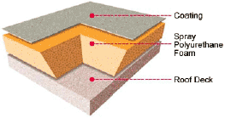
SPF ROOF
*SPFA

Slide 3
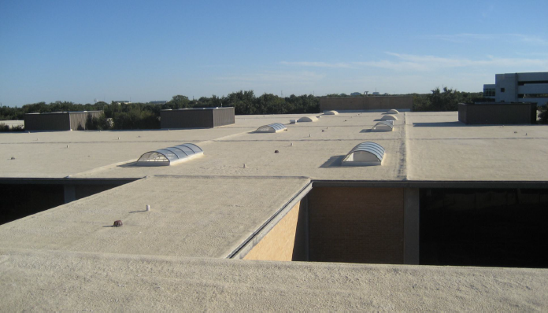
SPF ROOF
IBC Section 1507.14 - Coated Foamed Roofing
The NRCA Roofing Manual – Metal Panel and SPF Roof Systems
FM 4470 / 4474 Severe Hail Rated Roofing Systems
UL Fire Classified – UL790 Class A and Class B Assemblies
Florida Building Code – High Velocity Hurricane Zone
Miami Dade Approvals
CRRC Reflective Roof Rated
Code Compliant Research Reports
ISO 9001 Certified Manufacturers

Slide 4
SPF ROOF
Spray Foam
  ASTM C1029
  Low GWP HFO Roof Foam
Acrylic Roof Coatings
  ASTM D6083 Type I
Silicone Roof Coatings
  ASTM D6694

Slide 5
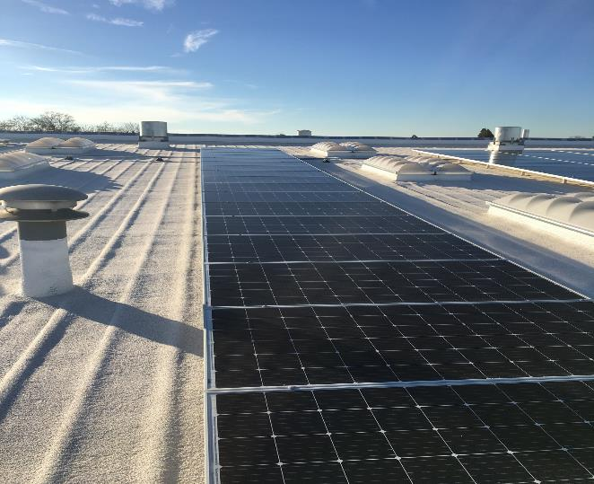
SPF ROOF
Warehouses, Cold Storage, Commercial, Institutional, Industrial, Residential
New Construction
  Metal Deck
  Structural Concrete
  Plywood
  Protection Board
Recover over Existing Roof Systems
  Mod Bit
  BUR
Slope Classification 1/2:12 to Unlimited

Slide 6
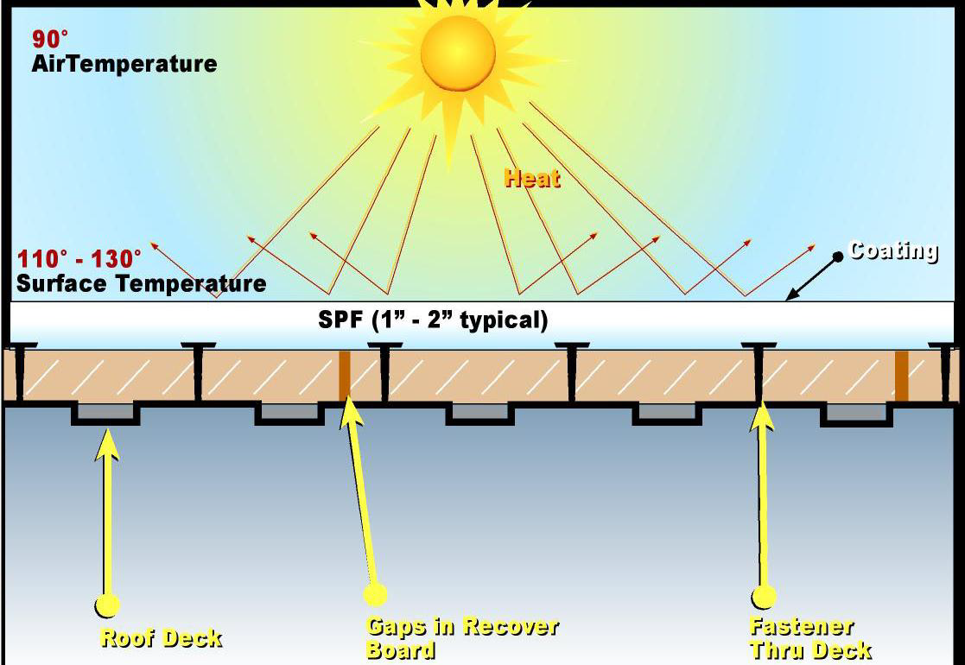
SPF ROOF

Slide 7
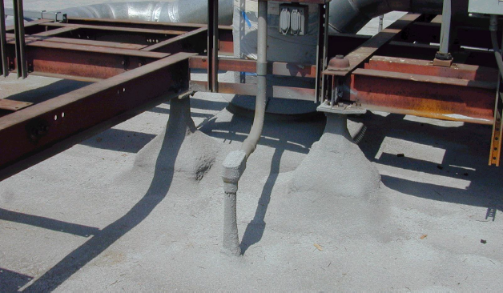
SPF ROOF FEATURES
Continuous exterior SPF can eliminate interior batt insulation
Enhance strength of the primary deck
Self-flashing around penetrations
Monolithic & No visible seams
Fully Adhered to Deck
No Thermal Shorts
Easily Repairable
Lightweight

Slide 8
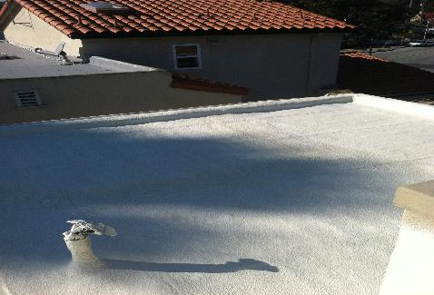
SPF ROOF BENEFITS
Energy Efficient with excellent solar reflectance
Mechanical damage by penetration is generally localized & insolated
Resistant to high winds or internal building air pressure
Roofs generally don’t leak after Severe Weather including Hail events
Minimally affected by short-term standing water.
Air Barrier Performance

